Slide 1



Illinois Emergency Management Agency
Radon in Illinois for Health Professionals
Patrick I Daniels
June 27, 2017
Illinois Emergency Management Agency

Slide 2
What is Radon?
Radon is an indoor air pollutant.
Radon is a colorless, odorless radioactive gas that comes from naturally occurring uranium in the soil.
The only way to tell how much radon a home has is to TEST.

Slide 3

How did radon originate in Illinois?
Glaciers from Canada deposited uranium in the soil.
Radon results from the uranium deposits.

Slide 4

EPA Map of Radon Zones

Slide 5

Extent of Glaciation

Slide 6

Radon Became an Issue in 1984
Mr. Stanley Watras set off alarms at the Limmerick
Nuclear Power Plant when entering.
The Watras case brought the indoor radon problem
to the public attention and that of the USEPA.

Slide 7

Stanley Watras Home
Stanley Watras measured 2700 (pCi/L) of air in his Pennsylvania home.
Notes:
7

Slide 8
Surgeon General’s Warning
“Indoor radon is the second-leading cause of lung cancer in the United States and breathing it over prolonged periods can present a significant health risk to families all over the country.”

Slide 9
Radon Exposure
Radon and Radon Decay Products (RDPs) are breathed in and the Radon is exhaled.
RDPs remain in lung tissue and are trapped in the bronchial epithelium and emit alpha particles which strike individual lung cells and may cause physical and/or chemical damage to DNA.

Slide 10
What Happens when the Decay Products Are Inhaled?
Decay Products
Radioactive particles adhere to lung tissue, where they can irradiate sensitive cells.
Radiation can alter the cells, increasing the potential for cancer.
Double Strand Breaks
Notes:
When radon decay products are inhaled they stick to sensitive lung tissue. Being short-lived, they will break down while they are in the lungs. This exposes the lung tissue to radiation.
If the alpha particle hits the live pulmonary epithelium DNA, it can damage the cancer suppressant genes and increase risk for contracting lung cancer. In addition to the alpha particle causing double and single strand DNA breaks, the alpha particle can also cause ionization of material around the DNA that can also damage it (shown on right of DNA strand).
This is the mechanism that radon (and more specifically the radon decay products) can lead to an increased risk of lung cancer.
What are the probability of this happening? It is based on how much radon you are exposed to and for how long.
I thank Doug Kladder for use of original slide that has been modified.

Slide 11
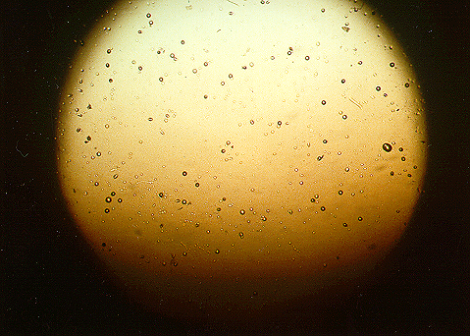
Alpha Particles
Alpha Particles are strong enough to pit plastic.
Notes:
11
To provide an idea of just how destructive the particles that are released when the decay products radioactively decay, the picture above shows a piece of plastic from a radon testing device that was placed in a home for 3 months containing, on the average, 4.0 pCi/L of radon. During this period of time the air in the room would diffuse (no air pump) through a paper filter into a small container where the piece of plastic was housed. When radon, and its decay products, decay within the container the resultant alpha particles strike the plastic hard enough to create pits. These pits are large enough to be seen under relatively low magnification (100 power). Note that the plastic is similar to plastics used in some eyewear.
Consider, if the alpha particles are forceful enough to create pits in plastic they are certainly forceful enough to impact, penetrate, and damage soft tissue. This is what happens in the lungs. Also consider that the act of breathing causes approximately 20,000 liters of air to b inhaled and exhaled on a daily basis, thus bringing far more radon decay products into the lungs than would have diffused (drifted) through a paper filter and into the plastic casing that housed this piece of plastic.

Slide 12
Radon Action Level
4.0 picocuries of radon per liter of air (pCi/L).
USEPA selected 4.0 pCi/L because of the technological and economical bases.
Risk at 4.0 pCi/L about seven (7) non-smokers out of a thousand could get lung cancer.*
*A Citizen’s Guide to Radon (2005).

Slide 13
Radon Risk Estimates
USEPA’s 2003 Assessment of Risks from Radon in Homes estimates radon causes about 21,000 lung cancer deaths per year.
The Illinois Emergency Management Agency and the USEPA estimate that as many as 1,160 Illinois citizens are at risk of developing radon related lung cancer each year.

Slide 14
Radon Risk in Perspective
Comparative Risk Assessments by EPA and its Science Advisory Board have consistently ranked Radon among the top four Environmental risks to the Public.
In 1998 Harvard Risk in Perspective, by John Graham, ranked Radon the #1 risk in the Home.

Slide 15
Cancer Mortality - 2015
CANCER TYPE | Estimated U.S. Deaths / Year
1. Lung and Bronchus | 158,040
2. Colon and Rectum | 49,700
3. Pancreas | 40,560
4. Breast Cancer | 40,290
5. Prostate | 27,540
6. Leukemia | 24,450
>>> Radon Induced Lung Cancer | 21,000
7. Non-Hodgkin Lymphoma | 19,790
8. Liver and Bile Duct | 17,030
9. Ovary | 14,180
CA Cancer Journal for Clinicians
Volume 65, Issue 1, Pages 5-29, 2015
Published Online: 5 Jan 2015
Copyright © 2015 American Cancer Society

Slide 16
Sources of Radiation Exposure
Source: National Council on Radiation Protection (NCRP Report 160)
Average Exposure 620 mrem.
Assumes average indoor radon concentration of
1.3 pCi/L.
Radon is by far the greatest single source of radiation exposure to the general public.
Other - 1%
Radon - 37%
Medical X-Rays - 12%
Internal - 5%
Nuclear Medicine – 12%
CAT Scans - 24%
Consumer Products - 2%
Cosmic - 5%
Terrestrial - 3%
Notes:
16
Script: 55% of the radiation that people are exposed to comes from radon and its progeny. The average indoor radon concentration nationwide is 1.3 pCi/L and the ambient air is approximately 0.4 pCi/L. In Illinois, the average ambient level is almost 0.6 pCi/L according to the results reported by USEPA in their study, the National Ambient Radon Study that was mandated by the Indoor Radon Abatement Act of 1988. Radon is the greatest source of radiation exposure to the public.

Slide 17
Action Level Exposure
Average Exposure 1,170 mrem
Assumes average Illinois indoor radon concentration of
4.0 pCi/L.
Radon is by far the greatest single source of radiation exposure to the general public in Illinois.
Other - < 1%
Medical X-Rays - 6%
Internal - 2%
Radon - 63%
Nuclear Medicine – 6%
Consumer Products - 1%
Terrestrial - 2%
Cosmic - 3%
CAT Scans - 24%
Notes:
Script: 55% of the radiation that people are exposed to comes from radon and its progeny. The average indoor radon concentration nationwide is 1.3 pCi/L and the ambient air is approximately 0.4 pCi/L. In Illinois, the average ambient level is almost 0.6 pCi/L according to the results reported by USEPA in their study, the National Ambient Radon Study that was mandated by the Indoor Radon Abatement Act of 1988. Radon is the greatest source of radiation exposure to the public.

Slide 18

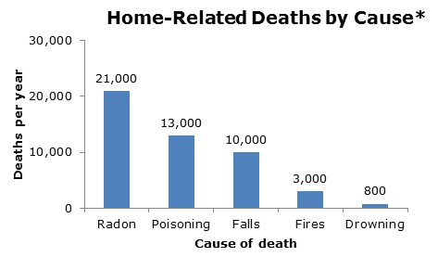
Did You Know?
Centers for Disease Control
and Prevention
Top five causes of accidental home injury deaths.
http://www.cdc.gov/cancer/dcpc/prevention/policies_practices/radon/index.htm

Slide 19
Radon is Found Everywhere
Every county in Illinois has had a high radon test.
41% of the homes according to the Status Report for Radon in Illinois are above the USEPA Action Level.

Slide 20
Illinois Statewide Results
118,447 Homes Tested
48,978 of the homes tested were > 4.0 pCi/L
41% of the homes tests were > 4.0 pCi/L
Average Radon Concentration 4.9 pCi/L

Slide 21
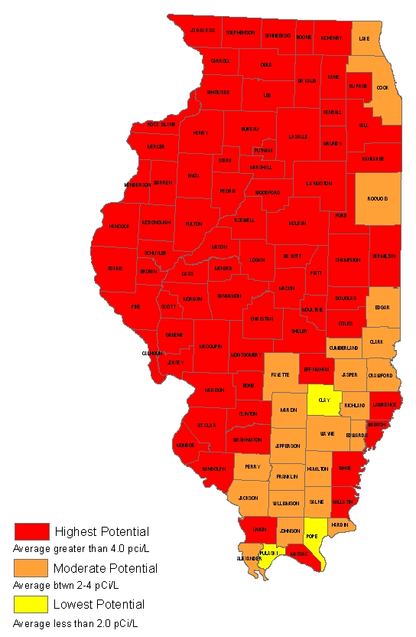
Illinois Statewide Results
Average Indoor Radon Concentration by County
The only way to tell how much radon a home has is to TEST.

Slide 22
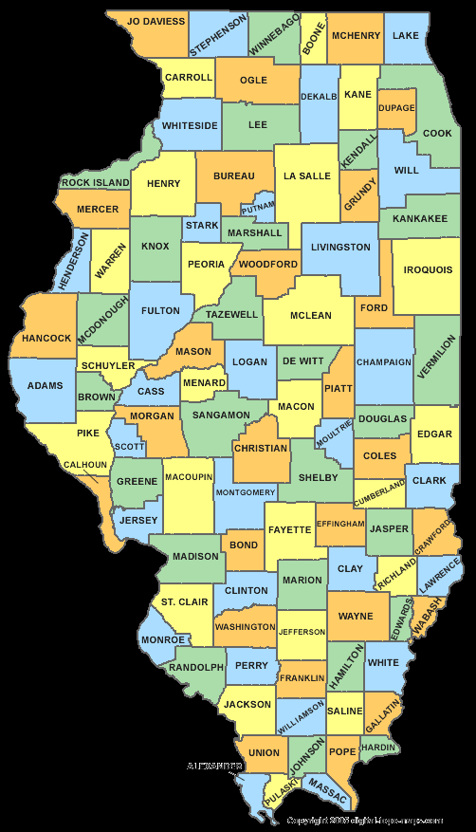
Highest Radon Measurements
City | Result
Peoria | 1,307.0
Le Roy | 442.5
Morrison | 362.6
Peoria | 257.1
Mascoutah | 196.6
Sterling | 190.0
Channahon | 178.9
Joliet | 176.0
Minooka | 162.0
Charleston | 148.0

Slide 23
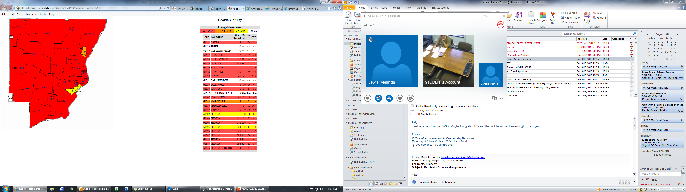
Highest Radon Measurements
Peoria County Average Radon Concentration is 6.2 pCi/L
4,300 Homes Tested
2,264 Tested >4pCi/L
53% Above Action Level

Slide 24
Radon Entry
Radon enters through any opening between the building and the soil.
radon
radium
uranium
Notes:
Script: Radon enters houses and other buildings through openings to the soil. Air pressure and temperature differentials between the interior and exterior of the structure causes it to act like a vacuum cleaner and to draw in radon and other soil gases through openings to the soil. Uranium, thorium and radium are solids, but when radium decays to radon the element radon is a gas and that facilitates entry into homes and other buildings.
Radon comes from the radioactive decay of naturally-occurring uranium and thorium in the soil. Radioactive decay is not like biological decay. When radioactive decay occurs, the original element (uranium, in this case) is called the parent and a new element (radium) is created and is called the decay product (or progeny). If the decay product is also radioactive - which radium is - it will decay creating another element (radon) and so on… The sequence of consecutive elements formed by radioactive decay is called a decay series or decay chain. In the uranium decay series, radon is the only gaseous element. Inhalation is the exposure pathway.

Slide 25
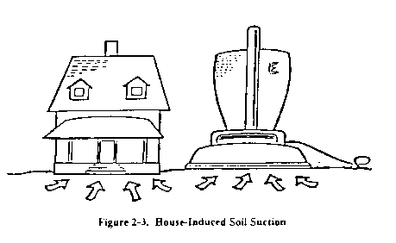
Pressure Differentials
Air pressure differentials between the building and outside air causes radon from the soil to be drawn into the house resulting in elevated indoor radon levels.

Slide 26
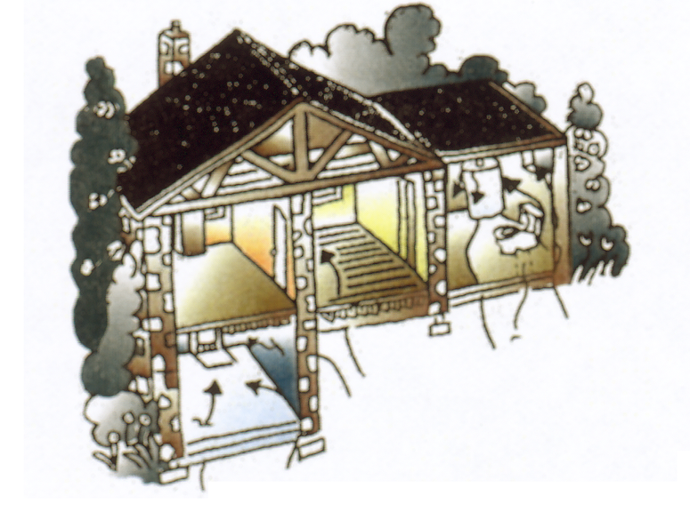
Common Entry Points
Foundation Wall Joint
Crawlspace
Sump Pits
Cracks in Floors
Utility Penetrations

Slide 27
Mitigation Systems
Collecting radon prior to its entry into the building and discharging it above the highest eave.
Modifying building pressure differentials.

Slide 28
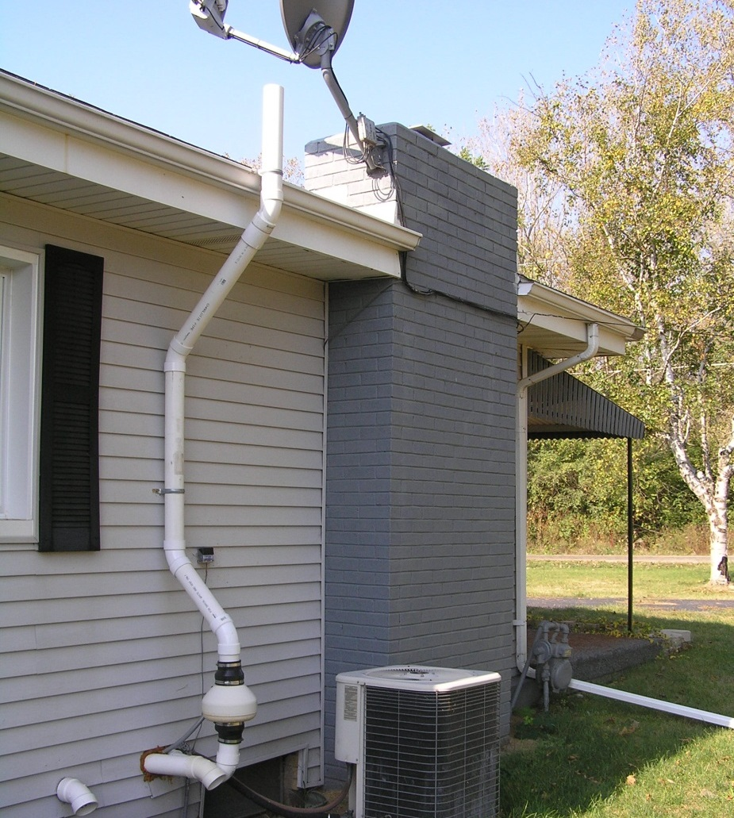
System on Existing Housing

Slide 29
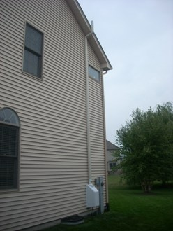
Radon Exposure vs. Aesthetics
Homeowners opt out or decide not to fix the radon problem in their new home because they do not understand the radiation exposure risk.
They are only concerned with how the exterior of their home looks.
Notes:
The Task Force brought back together the key players in passing the Radon Resistant Construction Act to develop the regulations that will be put in place .
The key to a successful installation and risk reduction will be training both building contractors and code officials so they understand how the passive mitigation systems work and what is needed to activate when necessary.

Slide 30
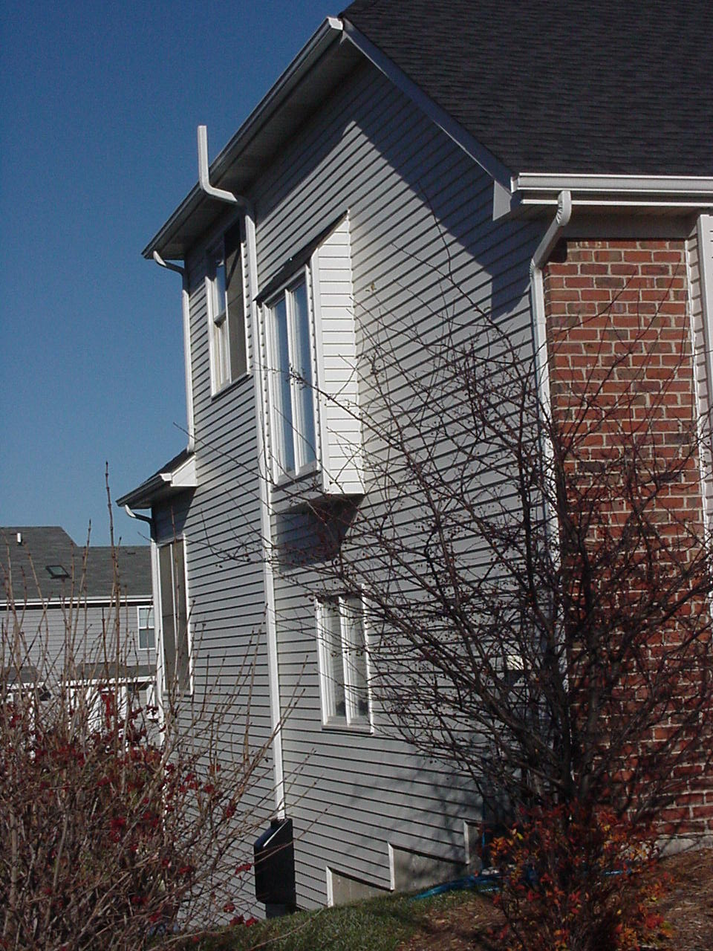
Illinois Path to a Radon Code
Illinois Real Estate Attorneys contacted their State Representative concerned about the aesthetics of mitigation systems on new homes.
Notes:
Representative Emily McAsey was contacted by Real Estate Attorneys who were her constituents. Rep McAsey is a former State Assistant District Attorney and knew the local Real Estate Attorneys in her district. We should note that her district is a Zone 2 county according to the USPEA map, but we know that approximately 50% of the homes in her district have elevated radon concentrations. As a note her district does border Argonne National Lab.
The concern was not with the health effects of radon exposure, or radiation exposure, but simply the aesthetics of the mitigation systems. Simply they just looked bad on new homes.
The Real Estate Attorneys wanted to solve this aesthetic problem for their clients and knew that some communities had adopted RRNC building codes and thought it should be a statewide requirement.

Slide 31

Legislation in Illinois

Slide 32
Radon Industry Licensing Act - 1998
Requires individuals providing radon measurement or mitigation services to be licensed.
Establishes the Task Force on Radon-Resistant Building Codes.

Slide 33

Real Property Disclosure Act
14. ..... ..... ..... I am aware of unsafe concentrations
of radon on the premises.
Notes:
Script: Illinois takes radon exposure seriously. In response to industry requests for more stringent regulations for radon measurement and mitigation, the former Illinois Department of Nuclear Safety (now the Illinois Emergency Management Agency) proposed The Radon Industry Licensing Act which was signed into law in July 1997 and became effective January 1, 1998. Illinois regulations implementing this Act, 32 IL. Adm. Code 422, Licensing of Radon Detection and Mitigation Services (the Radon Rule) became effective June 1, 1998. The Radon Industry Licensing Act is a consumer protection act requiring that individuals who provide radon measurement and mitigation services be licensed with the Illinois Emergency Management Agency. Occupants are exempt from the Act if testing their own residence. The Act does not require that radon testing be performed.
There is no law requiring that a radon test be performed. However, the Illinois Residential Real Property Disclosure Act requires sellers to disclose known radon levels of 4.0 picocuries per liter of air (pCi/L) or more. The United States Environmental Protection Agency (USEPA) has designated 4.0 pCi/L as the Action Level, the level at which mitigation is recommended to reduce indoor radon levels.

Slide 34

Radon Awareness Act - 2008
Mandated disclosure of radon risks and measurement information by a seller to a buyer prior to the buyer making an offer to purchase a home.

Slide 35

Illinois School Code - 2010
Recommends all school facilities in Illinois have radon measurements performed once every 5 years.

Slide 36

Illinois Child Care Act - 2013
Requires daycares to test for radon once every 3 years.

Slide 37

Radon Resistant Construction Act - 2013
Mandates that all new homes built after June 1, 2013, must be built using techniques to reduce radon.

Slide 38




Contact Information
Patrick I Daniels / Radon Program Manager
Bureau of Radiation Safety
Illinois Emergency Management Agency
217 782-1325
patrick.daniels@illinois.gov
www.radon.illinois.gov
www.ready.illinois.gov
Illinois Emergency Management Agency

