Slide 1
“A community-driven partnership of public and private partners working together to address priority health issues in Peoria, Tazewell, and Woodford Counties of Illinois."
Notes:
Lisa F

Slide 2
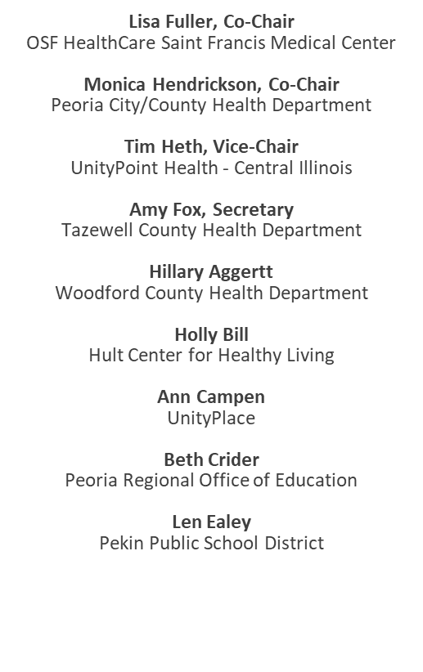
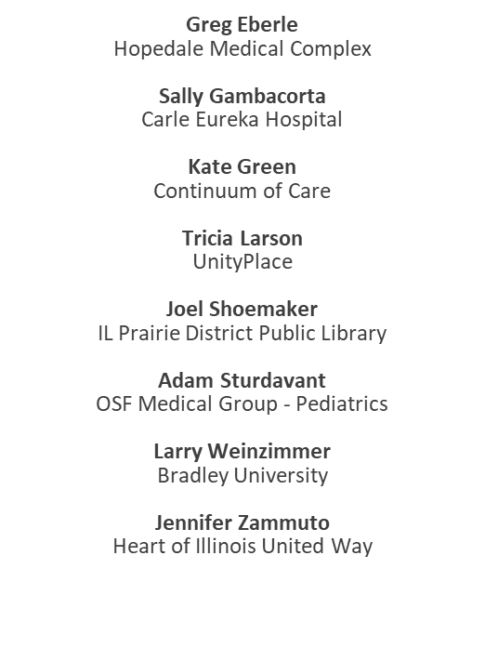
2021 Board Members
Notes:
Lisa F

Slide 3
Notes:
Monica H

Slide 4
Priority Health Areas
Mental Health
Substance Use
Four priority health areas were identified for the 2020-2023 cycle.
Cancer
Healthy Eating, Active Living
Notes:
Monica H; Transition to Holly B

Slide 5
Mental Health
Improve the mental health among tri-county residents through preventative strategies and increased access to services.
Notes:
HOLLY- Hello, My name is Holly Bill, and I am the co-chair, along with Tim Bromley for both the Substance Use and Mental Health Action Teams; our overall goal for Mental Health is to “improve mental health among tri-county residents through preventative strategies and increased access to services.” To achieve this, we have two objectives- decrease the number of suicides AND decrease the number of residents who report feeling depressed or anxious in the past 30 days. These are ambitious goals and objectives, especially with COVID giving us plenty of detours, but we have had a lot of stakeholders who are directly contributing to the successes we have had. List stakeholders- (slide?)-

Slide 6
Mental Health
Increase knowledge of mental health and reduce stigma.
School-Based Social-Emotional Instruction
Behavioral Health Primary Care Integration
Suicide awareness education
Notes:
HOLLY-Briefly review each intervention

Slide 7
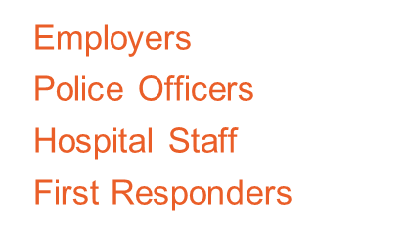
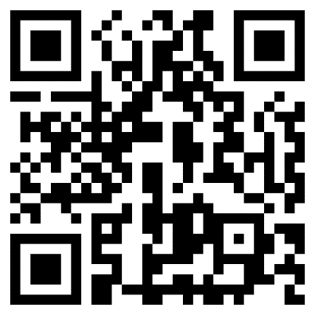
Interested in Getting Certified?
Notes:
HOLLY -We wanted to highlight a couple of our efforts this morning, starting with our Mental Health First Aid intervention. Mental Health First Aid teaches you how to identify, understand, and respond to signs of mental illness and substance use disorders. This evidence-based training is offered as an 8-hour in-person training, or a hybrid model that can be partially completed through a self-paced online course followed by an in-person skills-based training. We want Mental Health First Aid to be just a common as CPR and it’s appropriate for just about anyone!
This intervention has been highly successful thanks to our community partners who have come together under a newly formed “MENTAL HEALTH FIRST AID CADRE”. The cadre meets monthly is composed of MHFA trainers from Central Illinois- it was formed to 1) increase the number of trainers we have available to our community, 2) provide updated resources and networking for our trainers, 3) provide more training opportunities for our community so that we can increase the number of community members who are officially certified. Since the cadre formed, it’s grown in size, in fact we now have McLean and Stark Counties represented, and we’re even getting requests to join from as far as Chicago. Of course, our focus will still remain to increase the number of people trained within our tri-county area, but it’s great to see that the cadre intent is working and benefitting trainers and communities across the state.
If you are interested in this certification, please scan the QR code with your phone- you will see an updated list of trainings available and you can even make a specific request for yourself or an organization. You can also “contact us” to ask any questions.
I hope that you will read through the additional successes from the Mental Health Action Team in the Annual Report.

Slide 8
Substance Use
Reduce substance use to protect the health, safety, and quality of life for tri-county residents.
Notes:
HOLLY- We will switch our focus over to our Substance Use priority. The goal of the Substance Use Action Team is to “reduce substance use to protect the health, safety, and quality of life for tri-county residents.” We have two objectives: To reduce the rate of drug-induced deaths and increase the proportion of adolescents reporting never using substances in the tri-county. Again, these are lofty goals, and to accomplish this our community chose unique interventions….

Slide 9
Substance Use
Criminal Justice & Harm Reduction Strategies
Youth Leadership- Peer Educator Trainings
School-Based Classroom Instruction
Mass Media Campaigns
Notes:
HOLLY- Read through each intervention very briefly
Again, I hope you are able to review all of the efforts for this Action Team that are outlined in the annual report. To highlight one of our efforts, I would like to bring Kate Green, Executive Director of the Home for All Continuum of Care to the front to talk about the efforts to reduce homelessness.; Transition to Kate Green

Slide 10
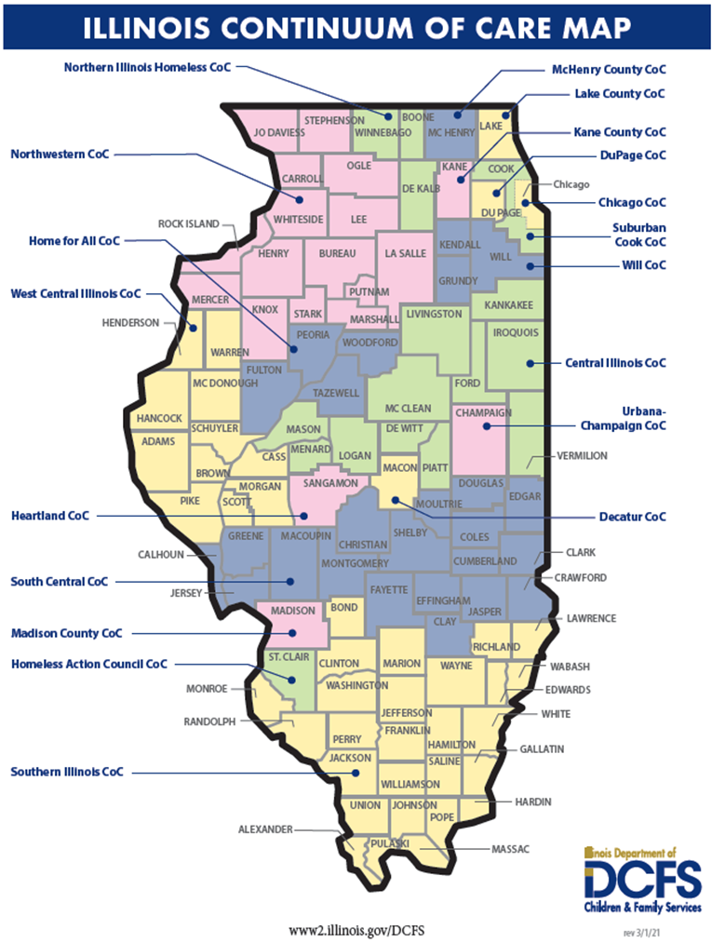
Addressing Homelessness
with Home for All Continuum of Care
Kate Green, Executive Director
Service Area: Peoria, Tazewell, Woodford & Fulton Counties
Over 50 community partners
Direct Service Providers
School Systems
Health Care
Criminal Justice
Faith Based Organizations
Cities
Advocates
Notes:
Kate Green

Slide 11
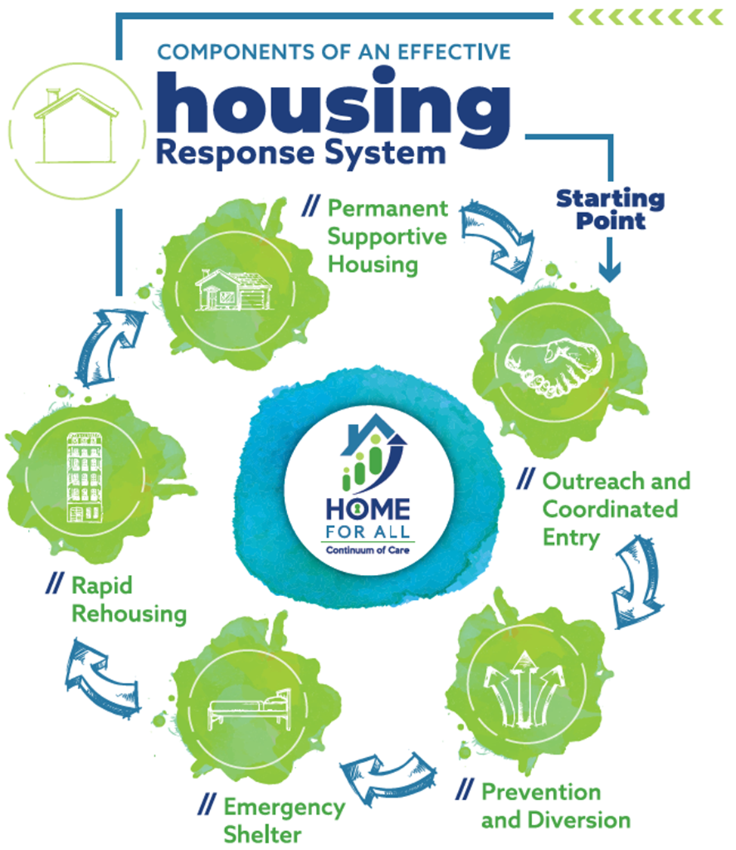
Notes:
Kate Green

Slide 12
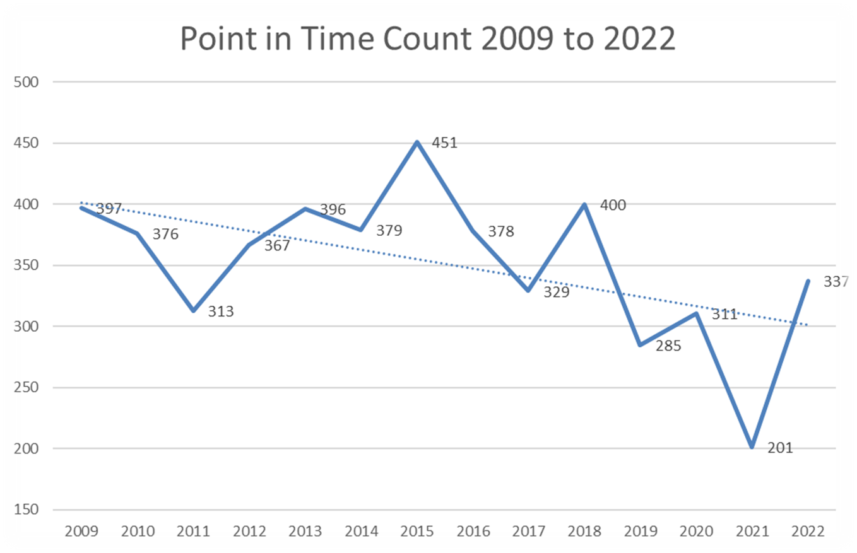
Notes:
Kate Green
HP: legal assistance, rent assistance, arrears, etc.
Street Outreach: dedicated team operated by licensed mental health agency
ES: Women, children, families; single men; fleeing DV
RRH: Time limited financial assistance supported by case management
PSH: Indefinite housing supported by case management
Community based resources: housing authorities, income-based properties, etc.

Slide 13
Cancer
Reduce the illness, disability, and death caused by lung, breast, and colorectal cancer in the tri-county area.
Notes:
Tom Cox

Slide 14
Cancer
Increase Breast, Lung, & Colorectal Cancer Screenings
Reduce tobacco use
Radon mitigation
Notes:
Tom Cox, Transition to HEAL

Slide 15
Healthy Eating, Active Living
To foster and promote healthy eating and active living to reduce chronic disease and food insecurity in the tri-county area.
Notes:
Shanita

Slide 16
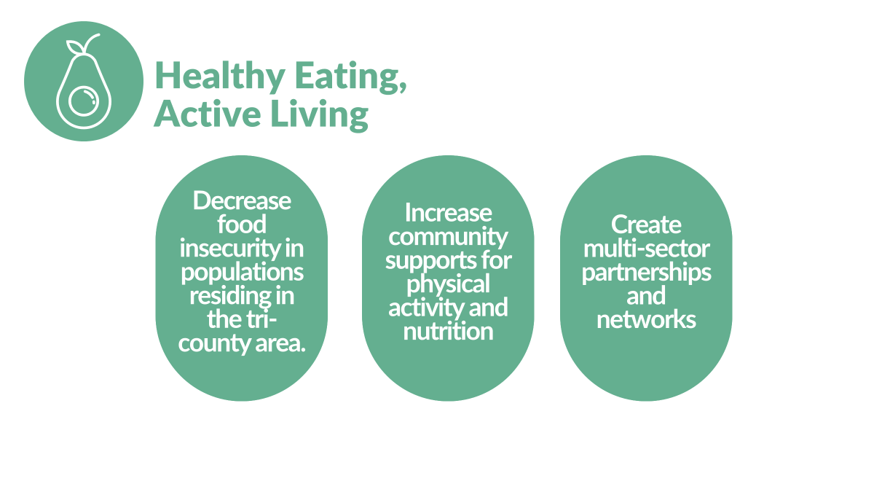
Notes:
Shanita

Slide 17
Notes:
Shanita/Dr. Amy Christianson, Rebecca Crumrine

Slide 18
Notes:
Shanita

Slide 19
Notes:
Shanita/Rebecca

Slide 20
Notes:
Shanita, Transition to Monica H

Slide 21
How can you get involved?
Visit our Website
Join a Committee
www.healthyhoi.org
Contact our chairs or a board member to join!

Slide 22
THANK
YOU
Notes:
Monica H

