Slide 3
Reproductive Health
2017-2019 Community Health Improvement Plan
Michelle Compton, RD, LDn, CLC
Child and Family Health Program Coordinator
Peoria City/County Health Department

Slide 4
2017-2019: Reproductive Health
Goal: Improve and promote reproductive and sexual health of adolescents and young adults
Objectives:
Reduce total preterm birth among Peoria County African American/Black women to 11.4% by 2019.
Reduce gonorrhea rates among men and women ages 15-44 years by 10% by 2019.
Reduce pregnancies among adolescent females age 15-19 years by 10% by 2019.

Slide 5
Strategies: The Work Being Done
Promotion of 5 P’s for sexual behavior history taking
GYT events and youth advisory councils
FLASH curriculum in Peoria Public Schools
Confidential coverage to adolescents through Planned Parenthoods Access Birth Control Initiative
CenteringPregnancy
PrEP trainings and events

Slide 6
Reproductive Health Highlight:
PrEP Continuing Medical Education (CME) Event & Results
Sokonie Reed, MSN, RN
Clinical Instructor
Bradley University

Slide 10
Cancer (Breast & Lung)
2017-2019 Community Health Improvement Plan
Greg Eberle, ATC, CEs, CEAs
Assistant Director of Sports Medicine
Hopedale medical complex

Slide 11
Lung Cancer:
Collaboration
Andrea Ingwersen
Health educator / Public Information Officer
Woodford County Health Department

Slide 12
Coordination: Addressing Tobacco and Radon
Policy Development
21 Tobacco-Free Policies
Policy Tracking: Tobacco21, Vaping, Flavor Bans, & Cannabis
Advocacy
Federal funding for tobacco prevention/cessation
EPA Radon funding
Workforce
430 Smoke-free Compliance Checks
33 Investigations
Education
300+ outreach activities
Collaboration
Data coordination
184 low-cost Radon screening

Slide 13
Breast Cancer:
Highlighting Breast Cancer Success.
Greg Eberle, ATC, CEs, CEAs
Assistant Director of Sports Medicine
Hopedale medical complex

Slide 14
2017-2019 Breast Cancer Priority
Goal:
Reduce the illness, disability and death caused by breast cancer in the Tri-County area.
Objective:
By 2019, reduce mortality rates by 3% as described by Healthy People 2020
Strategies:
Increase the rate of early stage breast cancer detection.
Increase the proportion on newly diagnosed women who receive breast cancer treatment

Slide 15
Intervention Highlights 2019
Policy development and use of mass media: Presented the Breast Cancer Position Statement
Advocacy and health equity: Supported Senate Bill 162 assuring diagnostic mammogram coverage
Collaboration, access to healthcare: Identified partners offering access to care in transportation for rural populations
Education, outreach, funding, health equity: Promoted the state breast cancer screening program, guaranteeing mammograms and related services to an increased number of uninsured women throughout the region

Slide 16
Accomplishments 2017-2019
Developed and promoted community breast cancer screening age guidelines
Assured patient reminder re-call systems, patient navigator systems and access to genetic counseling were in place at all regional hospitals
Provided over 54 education, awareness and recruitment events
Partnered with 6 organizations to provide culturally adapted education to all populations of women
Push for increased state program caseloads, funding, and medical homes for women with low income
Focused on data collection of mammogram screenings from 4 hospital systems in the tri-county region

Slide 17
Mammogram Screening Data
The primary age group that the breast cancer committee was tracking per the priority was ages 40 – 69
2017 – 36,825 screenings (total of all ages 40,315)
2018 – 31,726 screenings (total of all ages 41,598)
2019 – 30,706 screenings (total of all ages 40,678)

Slide 21
Healthy Eating & Active Living (HEAL)
2017-2019 Community Health Improvement Plan
Kaitlyn streitmatter, mph, ches
Extension educator, SNAP-Ed
University of Illinois Extension

Slide 22
Increase the number of adults and youth who meet the recommended daily servings of fruits and vegetables, and to increase number of adults and youth who meet recommended levels of weekly physical activity
2017-2019 Heal Action Team Goal

Slide 23
Strategies
CATCH
WIC
Coordinated Approach to Child Nutrition
USDA Supplemental Nutrition Program for Women, Infant and Children
ADULT NUTRITION
WORKPLACE WELLNESS
Food Insecurity

Slide 24
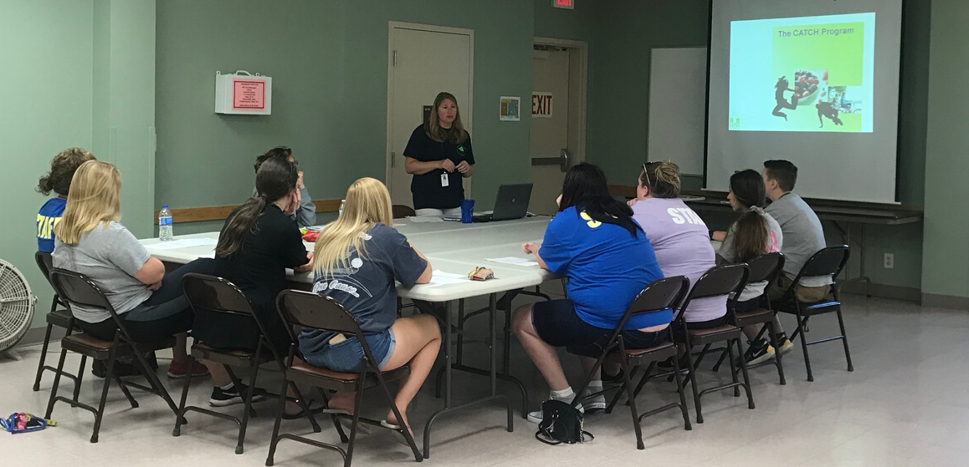
CATCH
Healthy Eating
Active Living
Community Training
18 after school programs received CATCH nutrition classes weekly
30 total lessons
90 lessons for 732 students =
1238.41 hours of physical fitness
9 Participants Trained

Slide 25
WIC: Worked to increase FMNP Redemption Rates
Cookbooks were provided to WIC participants recieving FMNP checks
Promotion of "Vegetable of the Month" including:
Health benefits
Recipes
How to prepare the food
Recipe demonstrations and samples by University of Illinois Extension
Actively messaging
Advocacy to increase FMNP throughout the state

Slide 26
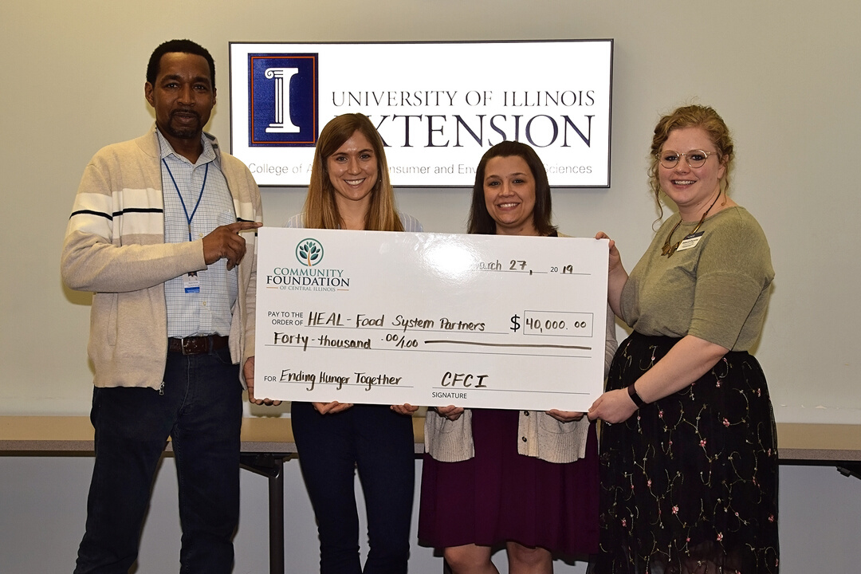
HEAL FOOD SYSTEM PARTNERS
Collaborative effort to increase healthy food, advance community education and create agricultural and community development for those that are food insecure in the tri - county
$40,000 Grant
Develop community-based collaboration model
Leverage strengths of partners to address food insecurity
2 Pilot projects
Cooking classes
Green light labeling system

Slide 27
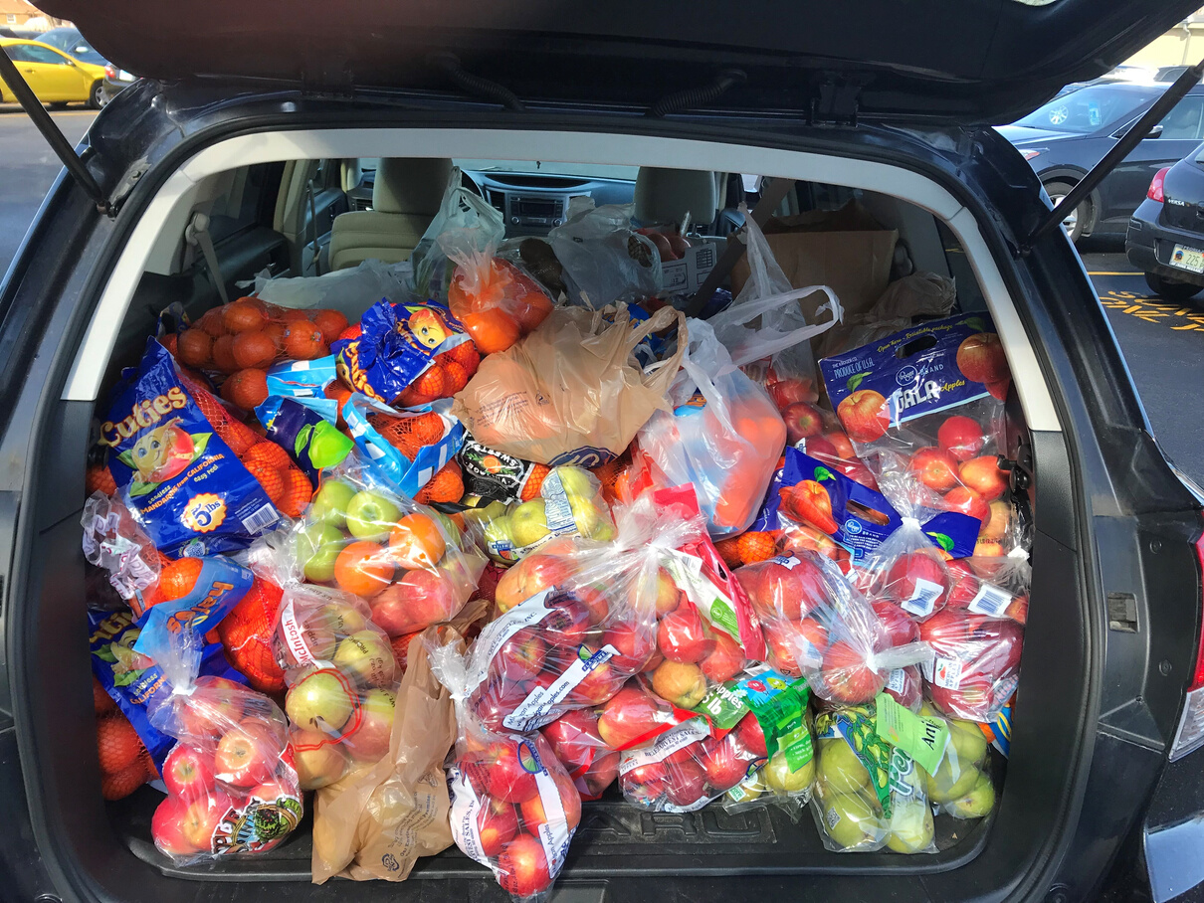
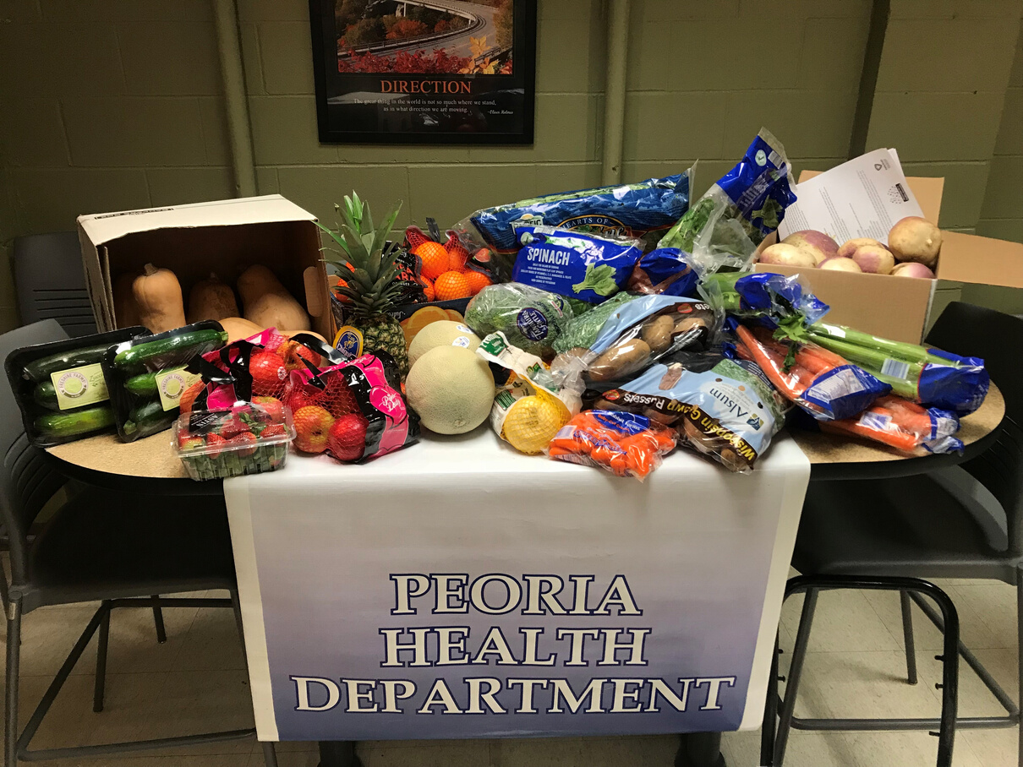
Fresh Food Drives
17 Food Drives
3,694 lbs donated

Slide 28
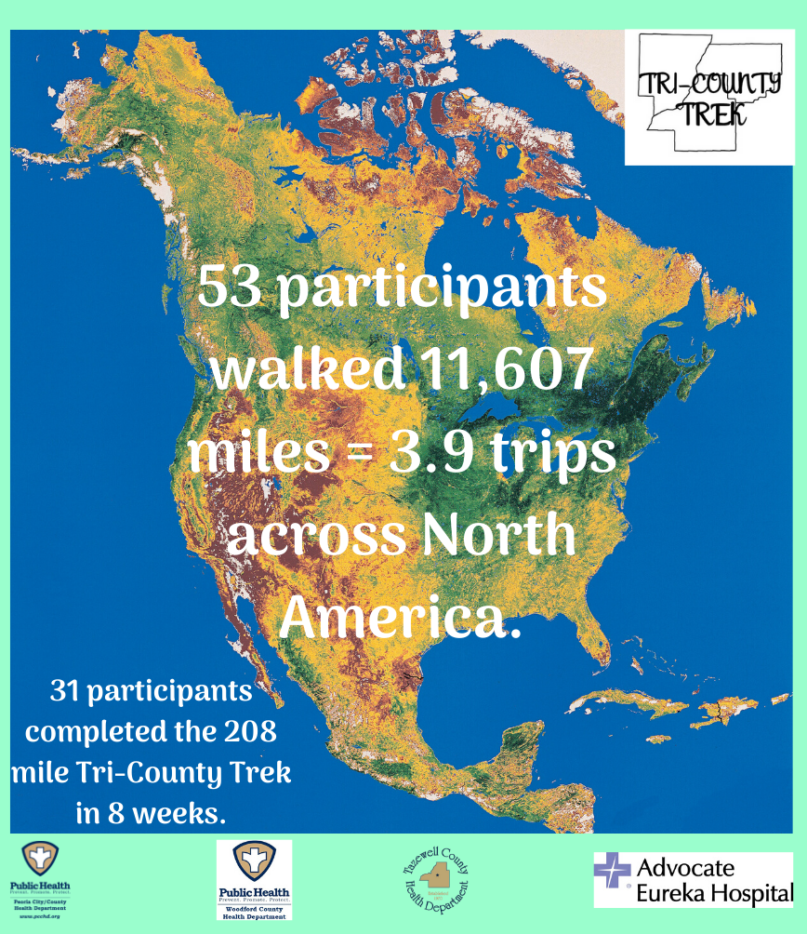

Slide 29
ISPAN: IL State Physical Activity and Nutrition Program

Slide 30
Food Pantry Network- HOI
The mission of this network is to support, connect and provide resources to those working
within the emergency food system. This network of community partners strives to
help alleviate hunger and build a healthier community.
Facebook Group
Food Bank
partnership
Resource Sharing
Networking
Trainings
listserve

Slide 32
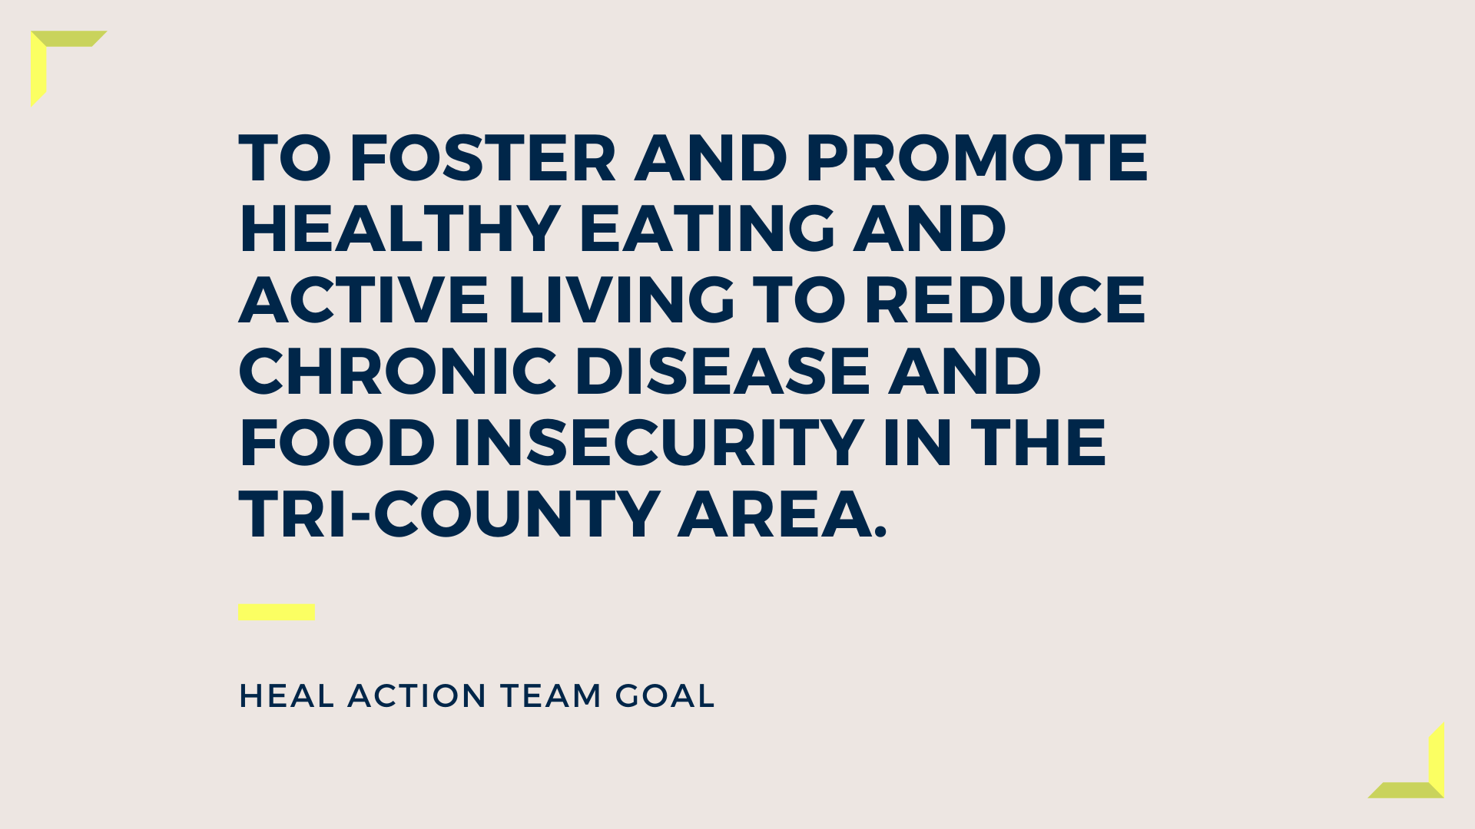

Slide 34
Behavioral Health: Mental Health & Substance Use
2017-2019 Community Health Improvement Plan
Monica Hendrickson, MPH
Public Health Administrator
Peoria City/County Health Department

Slide 35
Improve Mental Health through prevention and access to services and reduce Substance Use among tri-county residents
2017-2019 Behavioral health Action Team Goal

Slide 36
Strategies
Healthcare
Criminal Justice
Education

Slide 37
Criminal Justice:
Coordinating data and best practices.
Monica Hendrickson, MPH
Public Health Administrator
Peoria City/County Health Department
Chris Schaffner
Program coordinator
Jolt Harm reduction

Slide 38
Reporting Organizations
Advanced Medical Transport (AMT)
Bartonville Police Department (BPD)
East Peoria Fire Department (EPFD)
Human Service Center (HSC)
Pekin Fire Department (Pekin FD)
Peoria County Sherriff’s Office (PCSO)
Peoria Fire Department (PFD)
Peoria Police Department (PPD)
OSF Saint Francis Medical Center (OSF)
UnityPoint Healthcare (UPH)
West Peoria Fire Department (WPFD)
Notes:
The data presented in the following slides were submitted by the organizations listed here.

Slide 39
2018 Total = 611
2019 Total = 755

Slide 40
Residing Zip Codes with Narcan Administrations in the Tri-County Area

Slide 41
Supporting Evidence-Based Programming
Medication Assisted Treatment
PCCHD and HHS began offering MAT services in Fall 2019
Expansion of Harm Reduction Programming
Targeted outreach in high risk and marginalized populations.
Leave Behind Program
City of Peoria Fire Department provides Narcan kits at response sites.

Slide 42
Education:
Trauma-informed practices.
Beth crider
Regional superintendent
Peoria County

Slide 43
Trauma-Informed Practices
Trauma-informed care is not a therapy, intervention, or specific action. It is an approach to engaging people with histories of trauma that recognizes the presence of trauma symptoms and acknowledges the role that trauma has played in their lives. Trauma is extreme stress that overwhelms a person's ability to cope. It can be an event, a series of events, or set of circumstances that harms a person's physical or emotional well-being.

Slide 44
Four Elements of the Approach
/
Realizing the prevalence of Trauma
01
Recognizing how trauma affects individuals
02
Responding by putting this knowledge into practice
03
Resisting re-traumatization
04

Slide 45
Five Primary Principles
Safety
Transparency & Trustworthiness
Choice
Collaboration & Mutuality
Empowerment

