Slide 17
Notes:
Ok, great! It was the last 3 questions that all 3 counties added this year. We did that to try to gauge interest in having a market at the health department. Since the biggest barrier reported was time, we wanted to address that barrier. That is the only other thing I can think of to include on the slide

Slide 18
Notes:
Good Food Recovery: transitioning from GITM to TCHD. Partnership breakfast with food pantries from Taz Co.

Slide 44
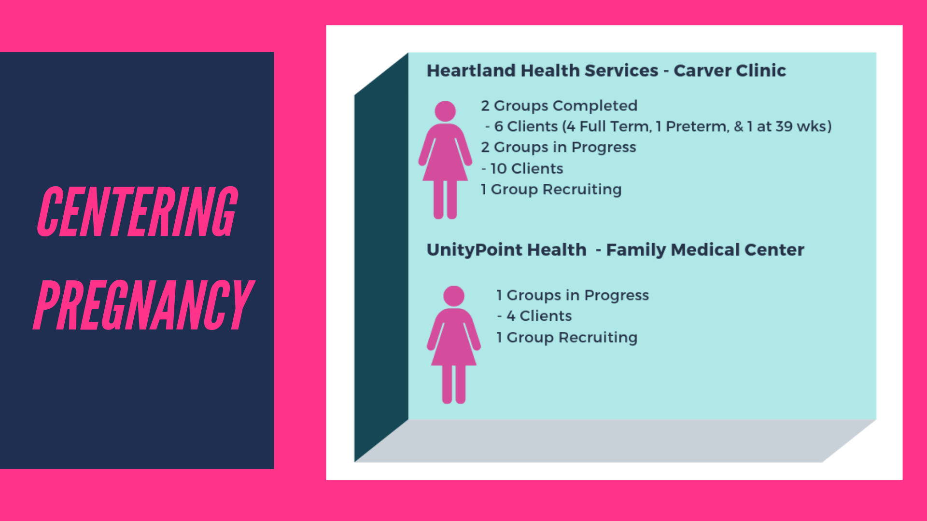

Slide 45
Thank you
www.healthyhoi.com

